Slide 1
Learning Elixir
Notes:
Wirlwind Tour of elixir
Tell the you are happy to not have cancelled because you are very soon going to become a dad
Get Elixir a feeling for audience and level of comfort with elixir

Slide 2
Who am I?
Driven Alliance
@tbohnenjnr
Notes:
I am someone that loves learning, especially learning new languages.
I do not claim to be an elixir expert, if I say something that is untrue or does not make sense, please help me learn by explaining to me afterwards.
Use it extensively in two of my side projects
In my side project that is a stocks portfolio manager for stocks on the jse I use a lot of technical analylsis
Technical analysis applies mathematical functions to prices of stocks to get an idea of what the price might do in the future.
SMA example
I’ve been using F# for this
F# wasn’t bad but it had so many issues on OSX and ubuntu that I spent more time figuring out how to run it and configure it than using it

Slide 3

Why Elixir?
Notes:
Why I started with Elixir:
Let’s not kid ourselves, Dave Thomas recommended it
Elixir Performance, not as fast as java or c
Concurrency: Example of busses that need to get people to an event
The more I used it the more I realized how awesome the language is

Slide 4
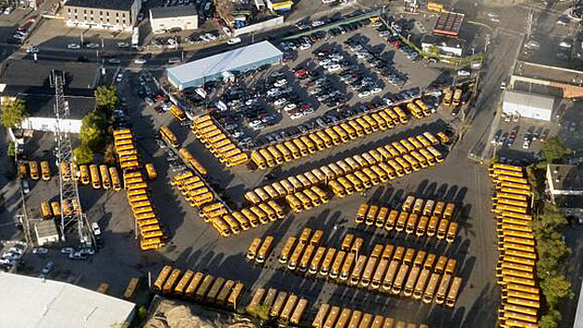
Why Elixir?
Notes:
Why I started with Elixir:
Let’s not kid ourselves, Dave Thomas recommended it and I’ve been enjoying working in dynamic languages like ruby
Elixir Performance, not as fast as java or c, it is a dynamic language
Concurrency: Example of busses that need to get people to an event
The more I used it the more I realized how awesome the language is

Slide 5
Some of the basics that I like
Tuples
Maps
Piping
Pattern Matching
Notes:
To set the stage I want to go through a couple of elixiry things
When you’re not sure about what type it is, use i and .module_info
Elixir data types are immutable but it does it under the covers
All of the examples are done in iex, the repl of elixir

Slide 6
Tuples
Notes:
Tuple is a list of any kinds of items
Stored contiguously in memory so accessing via index is fast
Updating / adding to tuples are expensive because it creates a copy of the whole tuple in memory
We use tuples a lot to pass multiple values back from functions

Slide 7
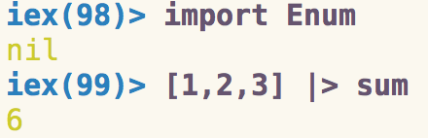
Piping
Notes:
Yes, I know most if not all functional languages has piping but I still feel like it’s worth a mention
Very well designed and feels natural in Elixir. Didn’t feel as great in F#
Mention the import part

Slide 8
Piping

Slide 9
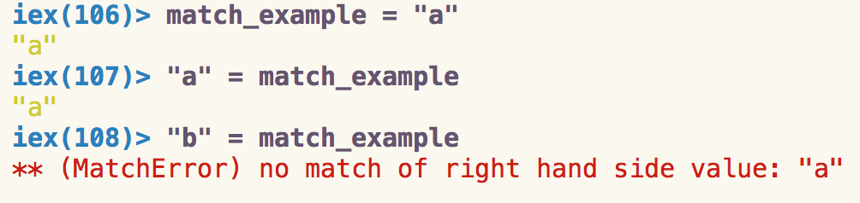
The Match Operator
Notes:
Immutable

Slide 10
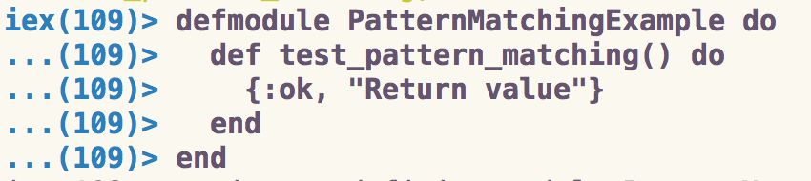
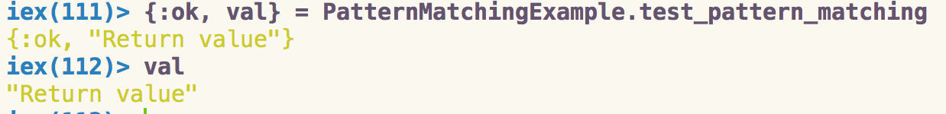
Pattern Matching
Notes:
Matching patterns inside data structures
Pattern matching is used extensively in Elixir. Used for error handling

Slide 11

OTP
Open Telecommunications platform
Notes:
OTP is a set of libraries that ships with Erlang.
OTP used by erlang devs to build robust, fault-tolerant applications. This is not a boast, it is true!
Explain example of telecommunications platforms
Processes – In Elixir, all code runs inside processes. Processes are isolated from each other, run concurrent to one another and communicate via message passing.
Agent – Simple wrappers around state

Slide 12

Gen_Server
Notes:
Gen Server - “Generic servers” (processes) that encapsulate state, provide sync and async calls, support code reloading, and more.
Gen Event - “Generic event” managers that allow publishing events to multiple handlers.

Slide 13
Supervisor
Failing Fast
Processes and computation are cheap and can be restarted, but data is sacred.
Strategies
:one_for_one
:one_for_all
:rest_for_one
:simple_one_for_one
Notes:
You link processes to the supervisor which in turn will decide what to do with it based on a strategy
Strategy: The supervision strategy dictates what happens when one of the children crashes

Slide 14

Hot Code Swapping
Notes:
Allows us to upgrade from one version to another without brining the application down.
Gen Servers have functions that you can implement that can transform state from one version to a next, look at Dave Thomas’s learning elixir
Imagine being to fix a bug without ha
ving to ask all your users to stop doing what they are busy with, easily…
Normally it’s quite complicated and tricky to do with erlang but exrm makes it a lot easier

Slide 15
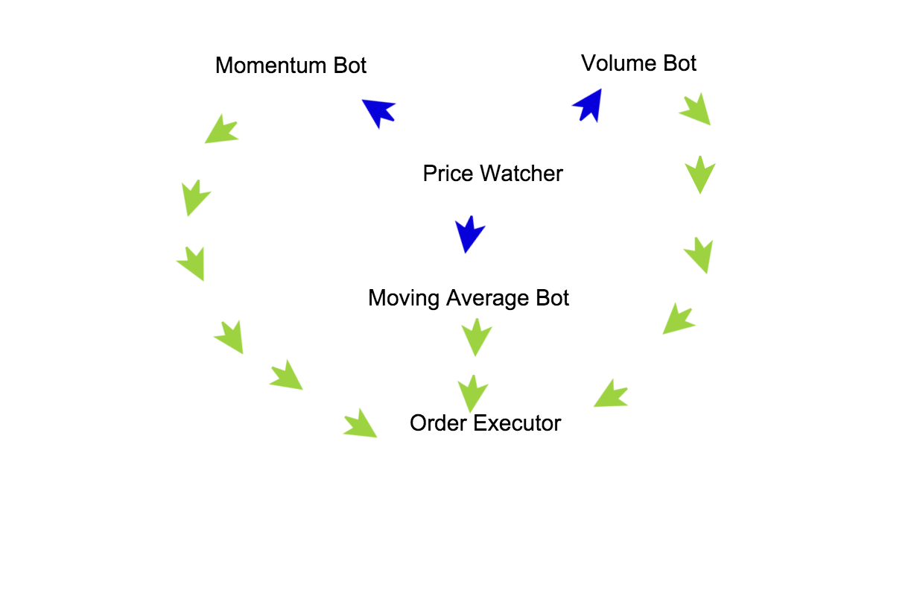
Trading Bot Example
Notes:
Bitcoin trading
Regression

Slide 16
Final Thoughts
Notes:
All of this power is available in erlang, Elixir just makes it easily accessible and easier to get started with
Absolutely love it, developer happiness
Learning Elixir
Jose Valim on irc
They are specific about what they include and what they don’t. Willing to talk about it.
Upgrdes
Shorthand for functions feels unnatural but you get use to it and great help in piping
Gettings started helped me a lot: http://elixir-lang.org/getting-started/

Slide 17
References
https://tkowal.wordpress.com/2015/10/20/failing-fast-and-slow-in-erlang-and-elixir

Slide 18
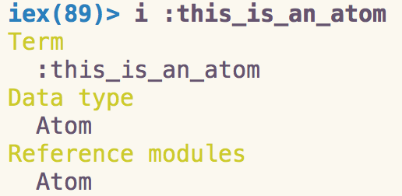

Atoms
Notes:
Similar to symbols in Ruby
There is only one reference in memory regardless of how many times they are used
Used a lot in matching

Slide 19
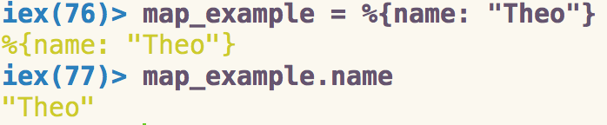
Maps

Slide 20
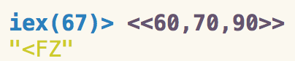
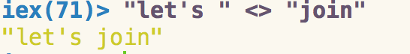
Strings
Notes:
Strings are utf-8 encoded binaries

Slide 21
Strings
Notes:
Bit strings that consist of a number of bits that are evenly divisible by eight, are called binaries, duh ☺

Slide 22
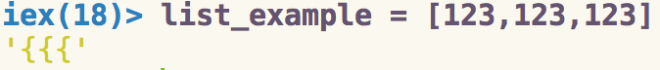
Lists
Notes:
Lists are stored as linked lists
Stored as linked lists so traversing is a linear operation.
Prepending to a list is fast
Elixir will print char list if it’s just ascii characters
Mention that it has normal functional functions like hd / tl and Enum which is eager and Stream which is lazy

Slide 23
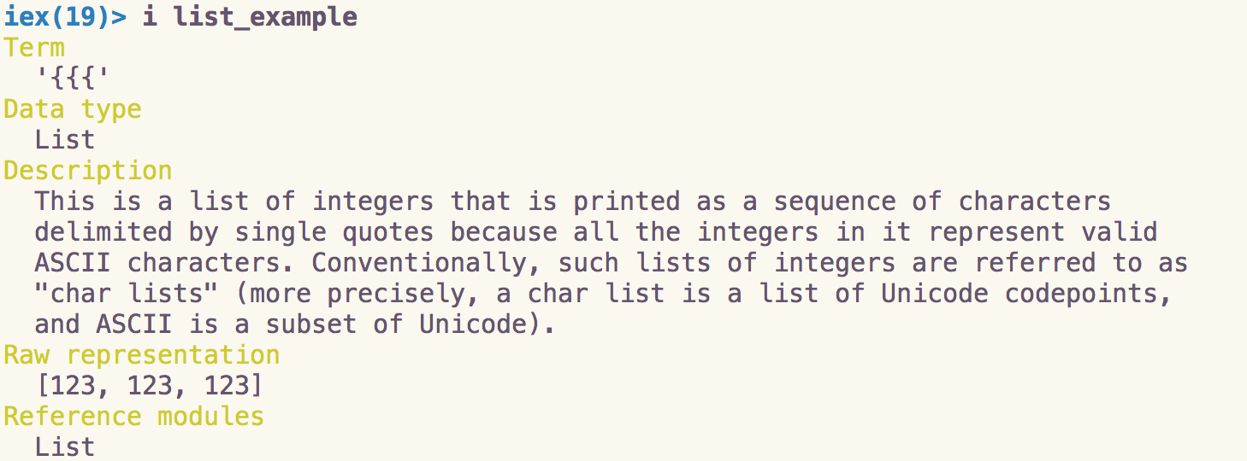
Lists
Notes:
I shows that it is a list even though it prints out as chars

Slide 24
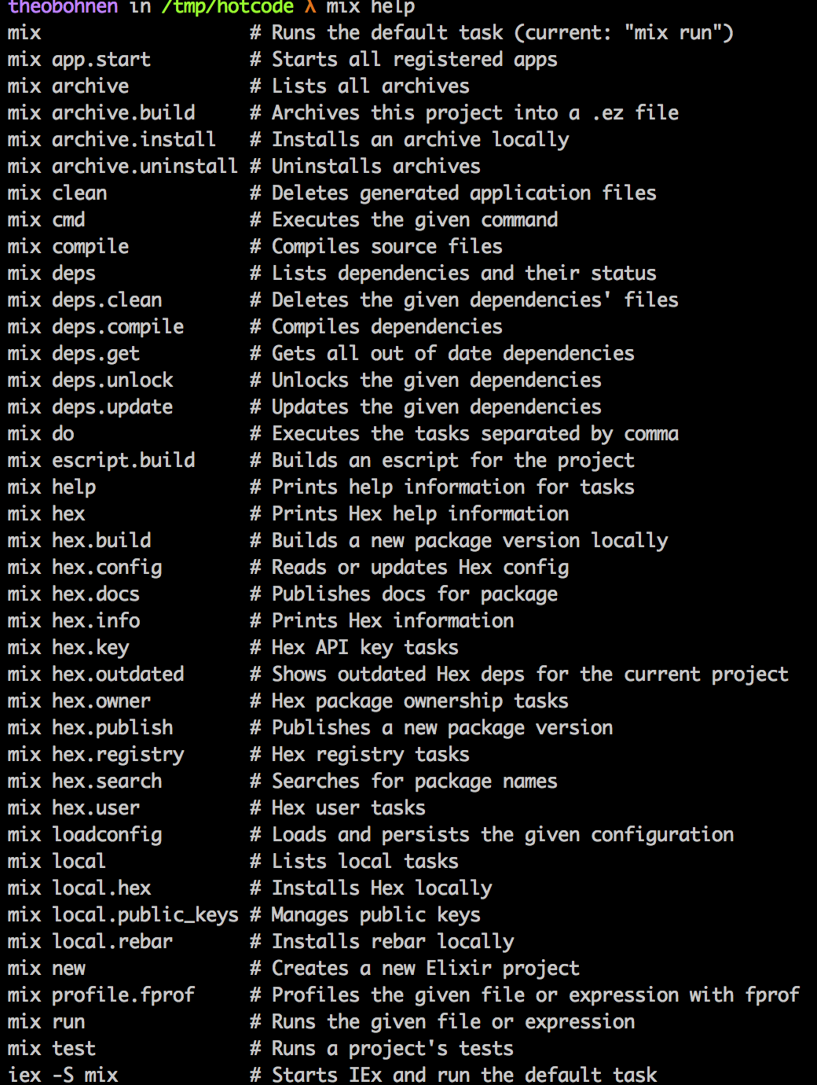
MIX
Notes:
Mix is a build tool, managing projects, dependencies, testing etc.
Mix help
When we talk about projects we talk about mix.

Slide 25
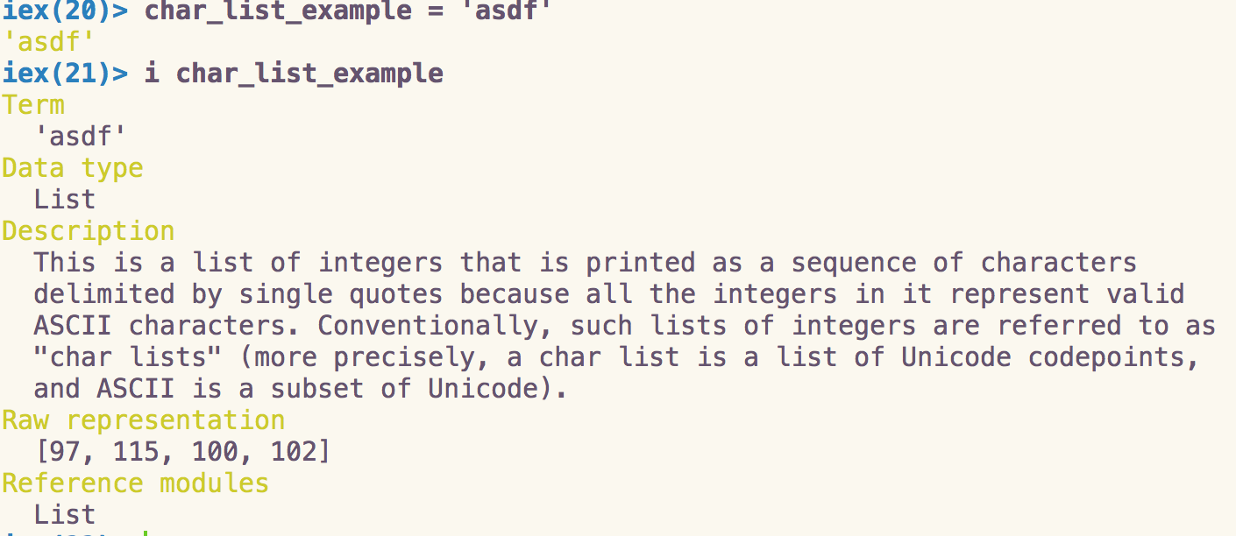
Lists
Notes:
Not to be confused with Strings that are denoted with “ as opposed to ‘
To better support erlangs libraries which may return text as char lists as opposed to Elixir strings

